Slide 1

Advanced Machine Learning Lab
Paper Summary
Máté Szűcs
2nd year Physics BSc Student

Slide 2
Introduction
Greydanus et al. – Hamiltonian Neural Networks
(Paper link)
Inspiration from Hamiltonian mechanics
Training models that learn and respect conservation laws
Evaluating them on problems where conservation of energy is important
Trains faster
Generalizes better, than regular neural networks
Code available at: github.com/greydanus/hamiltonian-nn

Slide 3
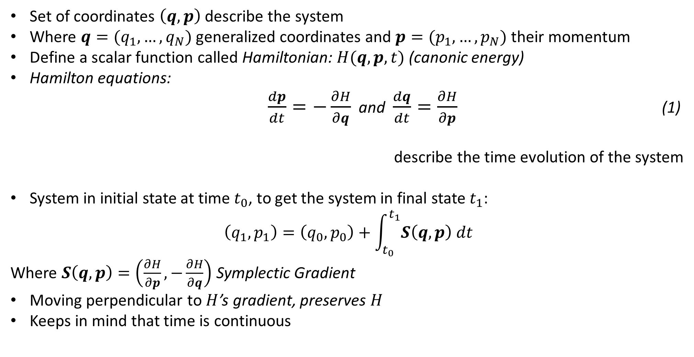
Hamiltonian mechanics
3
Set of coordinates $\left(q, p\right)$ describe the system
Where $q=(q_{1},…,q_{N})$ generalized coordinates and $p=(p_{1},…,p_{N})$ their momentum
Define a scalar function called Hamiltonian: $H(q, p, t)$ (canonic energy)
Hamilton equations:
$\frac{dp}{dt}=−\frac{∂H}{∂q}$ and $\frac{dq}{dt}=\frac{∂H}{∂p}$ (1)
describe the time evolution of the system
System in initial state at time $t_{0}$, to get the system in final state $t_{1}$:
$$\left(q_{1}, p_{1}\right)=\left(q_{0}, p_{0}\right)+\int_{t_{0}}^{t_{1}}{S\left(q, p\right) dt}$$
Where $S\left(q, p\right)=\left(\frac{∂H}{∂p},−\frac{∂H}{∂q}\right)$ Symplectic Gradient
Moving perpendicular to $H$’s gradient, preserves $H$
Keeps in mind that time is continuous

Slide 4

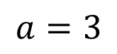
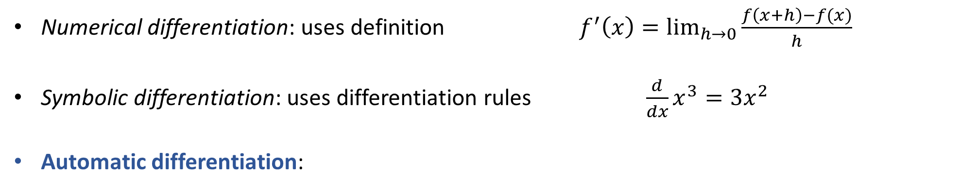

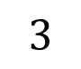
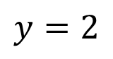
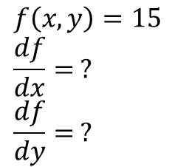
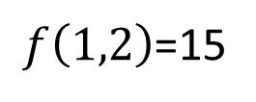
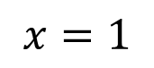
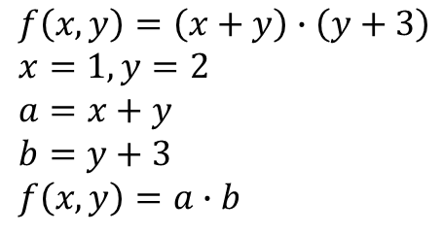

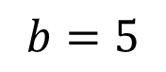
Automatic Differentiation
4
Numerical differentiation: uses definition ${ f}^{′}\left(x\right)=\lim_{h→0}{\frac{f\left(x+h\right)−f(x)}{h}}$
Symbolic differentiation: uses differentiation rules $\frac{d}{dx}x^{3}=3x^{2}$
Automatic differentiation:
$$f\left(x,y\right)=\left(x+y\right)∙\left(y+3\right)$$
$$x=1, y=2$$
$$a=x+y$$
$$b=y+3$$
$$f\left(x,y\right)=a∙b$$
$f\left(1,2\right)$=15
Forward: evaluating nodes
$$∙$$
$$a=3$$
$$b=5$$
$$f\left(x,y\right)=15$$
$$\frac{df}{dx}= ?$$
$$\frac{df}{dy}= ?$$
$$+$$
$$+$$
$$x=1$$
$$y=2$$
$$3$$
(Source)

Slide 5
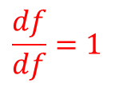
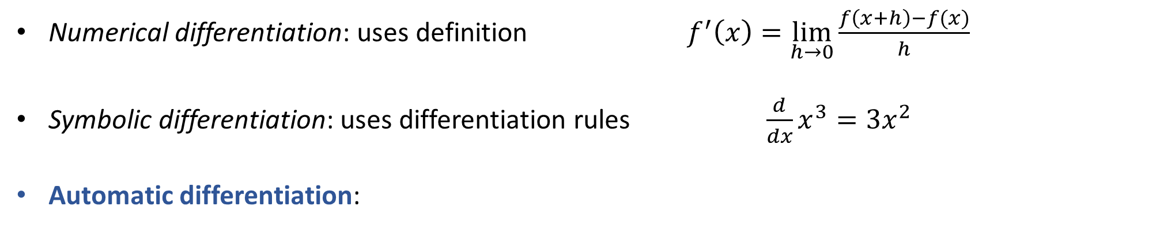
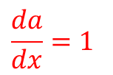
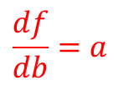
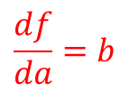
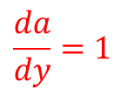
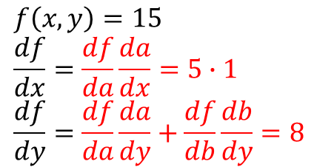
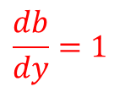
Automatic Differentiation
5
Numerical differentiation: uses definition ${ f}^{′}\left(x\right)=\lim_{h→0}{\frac{f\left(x+h\right)−f(x)}{h}}$
Symbolic differentiation: uses differentiation rules $\frac{d}{dx}x^{3}=3x^{2}$
Automatic differentiation:
$$f\left(x,y\right)=\left(x+y\right)∙\left(y+3\right)$$
$$x=1, y=2$$
$$a=x+y$$
$$b=y+3$$
$$f\left(x,y\right)=a∙b$$
$f\left(1,2\right)$=15
$$\frac{df}{df}=1$$
Backward: computing gradients
Using chain rule
$$\frac{df}{da}=b$$
$$∙$$
$$\frac{df}{db}=a$$
$$a=3$$
$$b=5$$
$$f\left(x,y\right)=15$$
$$\frac{df}{dx}=\frac{df}{da}\frac{da}{dx}=5∙1$$
$$\frac{df}{dy}=\frac{df}{da}\frac{da}{dy}+\frac{df}{db}\frac{db}{dy}=8$$
$$+$$
$$+$$
$$\frac{da}{dx}=1$$
$$\frac{da}{dy}=1$$
$$\frac{db}{dy}=1$$
$$x=1$$
$$y=2$$
$$3$$
(Source)

Slide 6
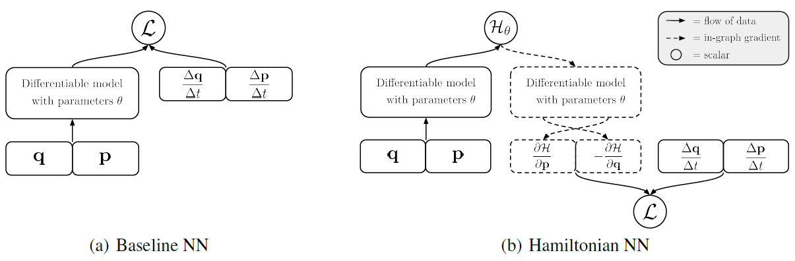
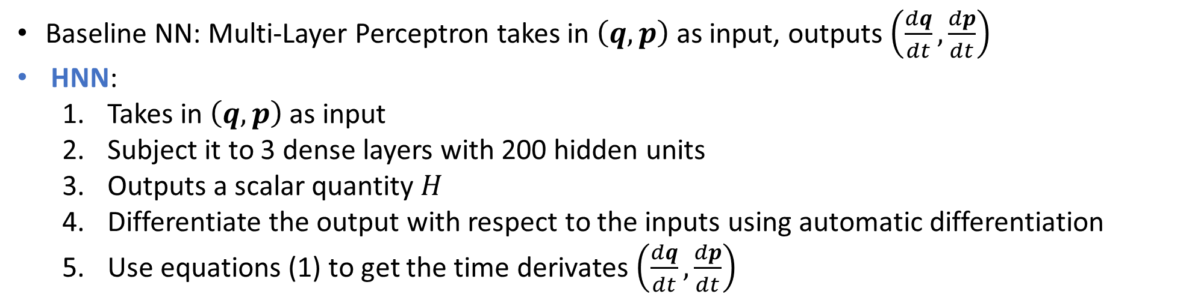
The model
6
Baseline NN: Multi-Layer Perceptron takes in $\left(q,p\right)$ as input, outputs $\left(\frac{dq}{dt},\frac{dp}{dt}\right)$
HNN:
Takes in $\left(q,p\right)$ as input
Subject it to 3 dense layers with 200 hidden units
Outputs a scalar quantity $H$
Differentiate the output with respect to the inputs using automatic differentiation
Use equations (1) to get the time derivates $\left(\frac{dq}{dt},\frac{dp}{dt}\right)$

Slide 7
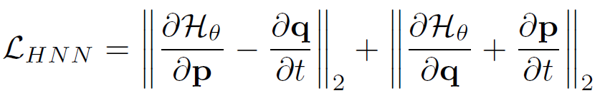
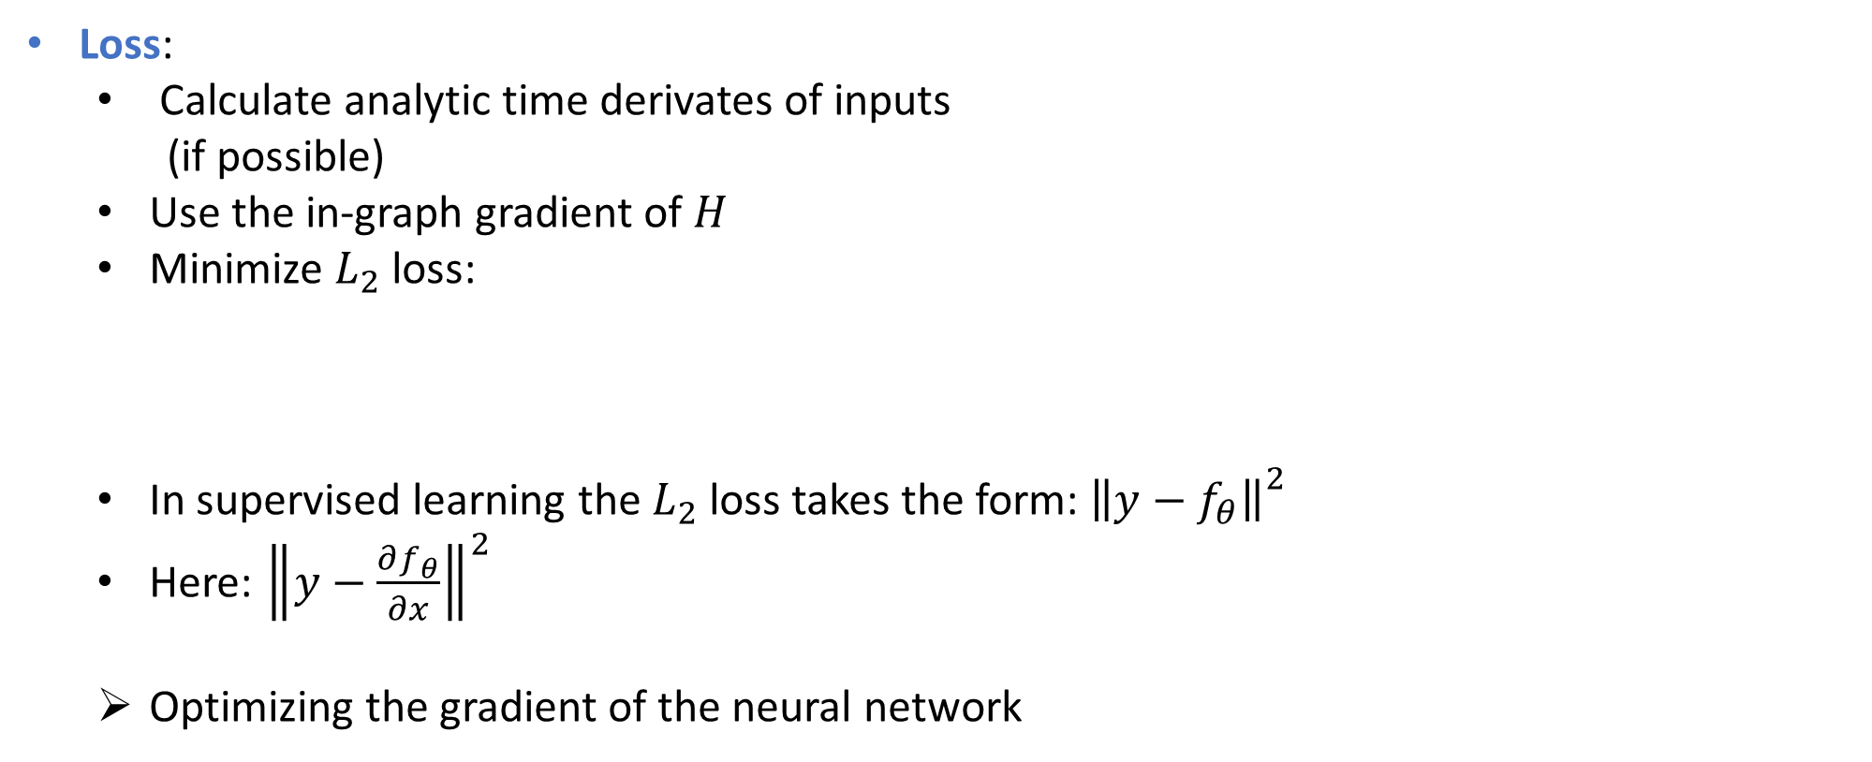
The model
7
Loss:
Calculate analytic time derivates of inputs
(if possible)
Use the in-graph gradient of $H$
Minimize $L_{2}$ loss:
In supervised learning the $L_{2}$ loss takes the form: ${\left\|y−\left.f_{θ}\right\|\right.}^{2}$
Here: ${\left\|y−\left.\frac{∂f_{θ}}{∂x}\right\|\right.}^{2}$
Optimizing the gradient of the neural network

Slide 8
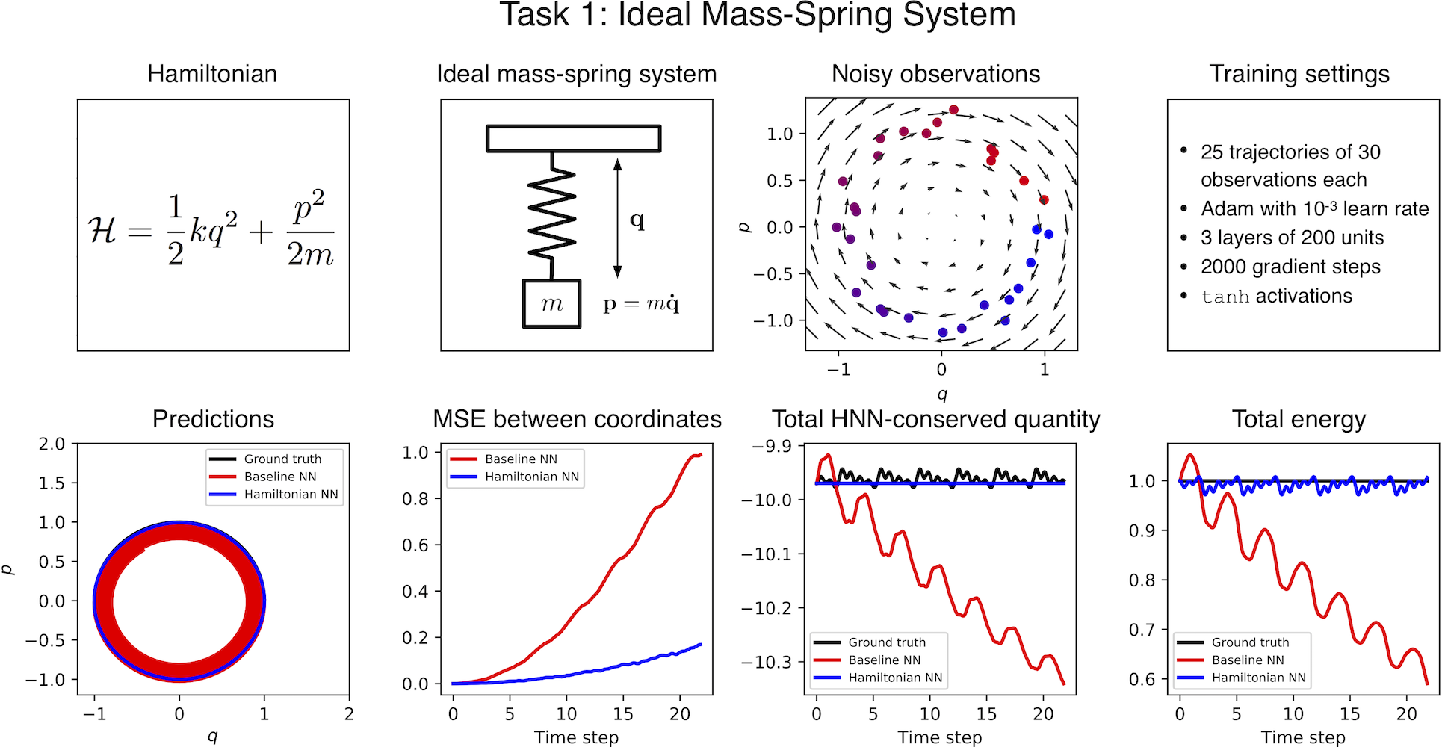
Learning a Hamiltonian from data
8
Task 1: Ideal Mass-Spring System (from simulations)

Slide 9
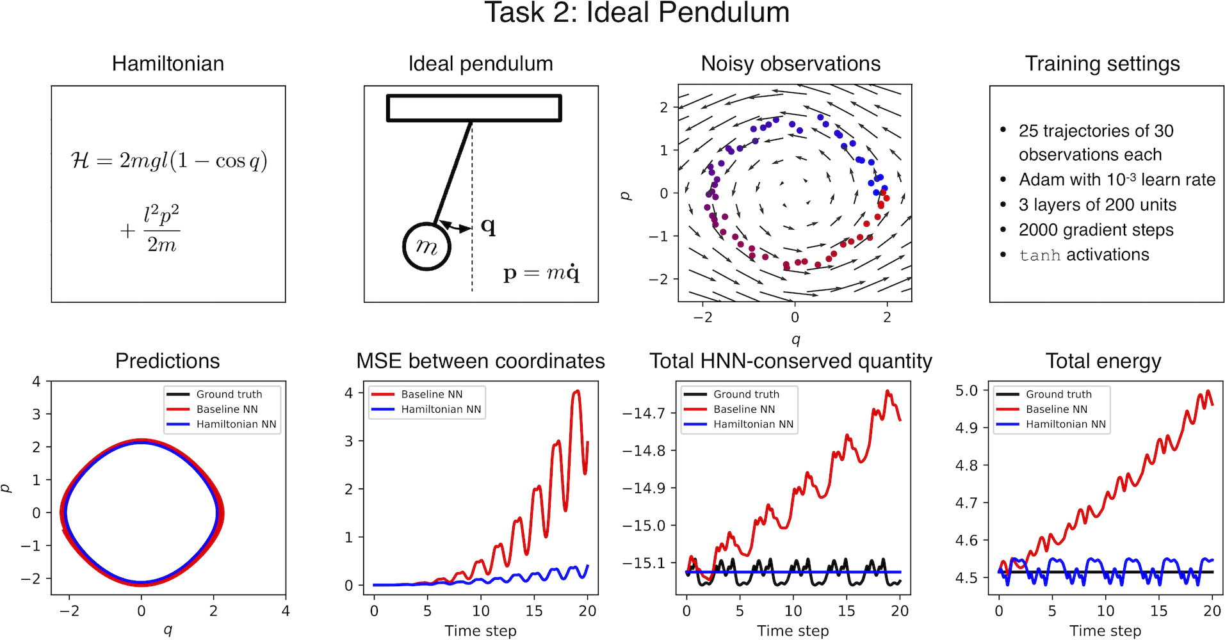
Learning a Hamiltonian from data
9
Task 2: Ideal Pendulum (from simulations)

Slide 10
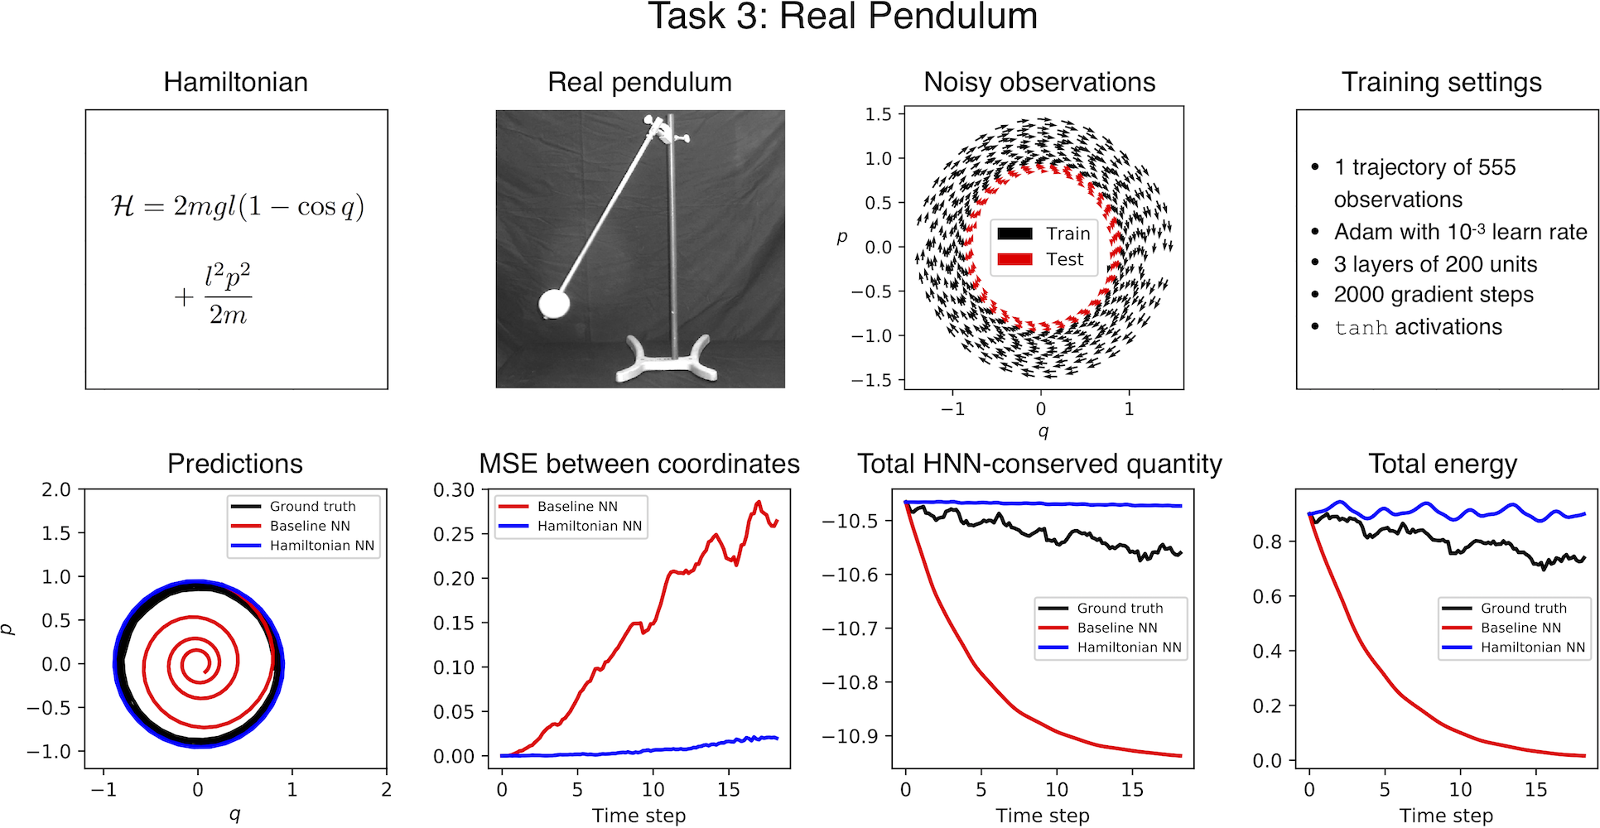
Learning a Hamiltonian from data
10
Task 3: Real Pendulum

Slide 11
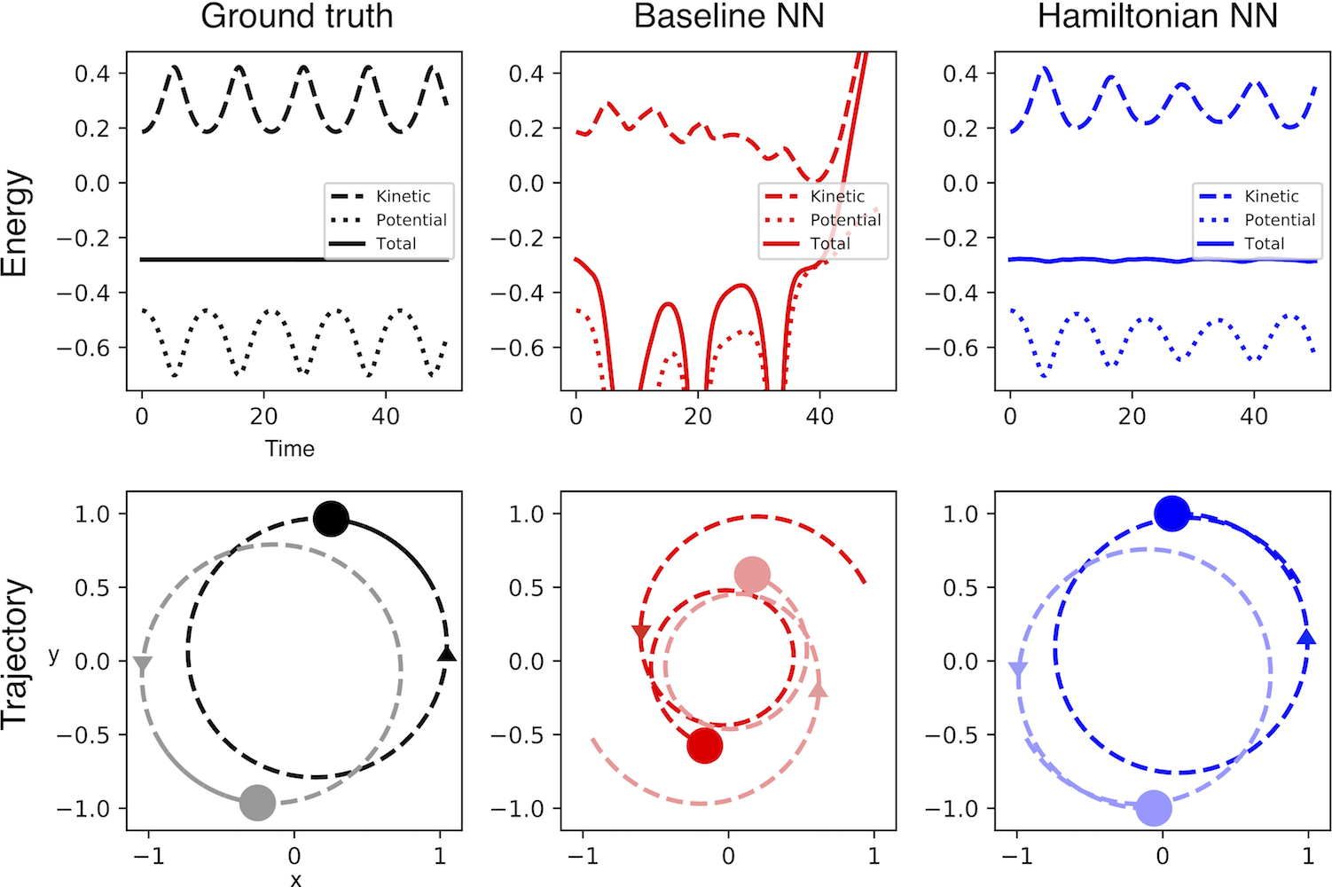
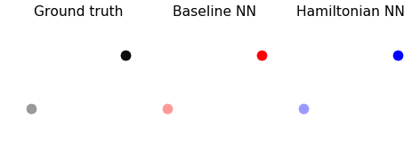
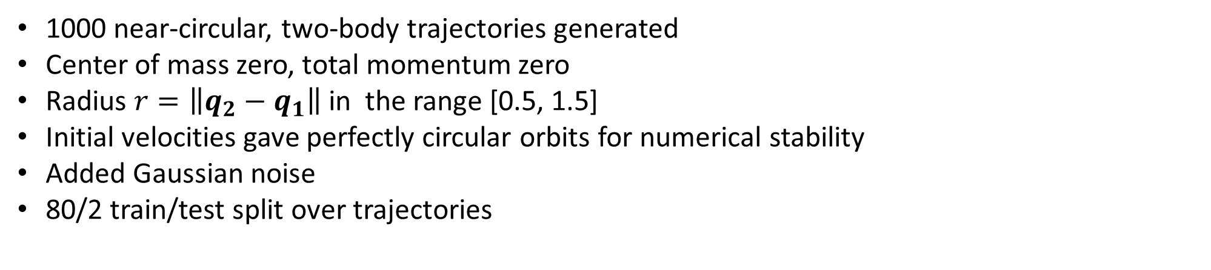
Two-body problem
11
1000 near-circular, two-body trajectories generated
Center of mass zero, total momentum zero
Radius $r=\left\|q_{2}−\left.q_{1}\right\|\right.$ in the range [0.5, 1.5]
Initial velocities gave perfectly circular orbits for numerical stability
Added Gaussian noise
80/2 train/test split over trajectories

Slide 12
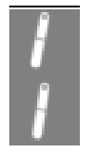
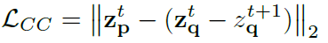
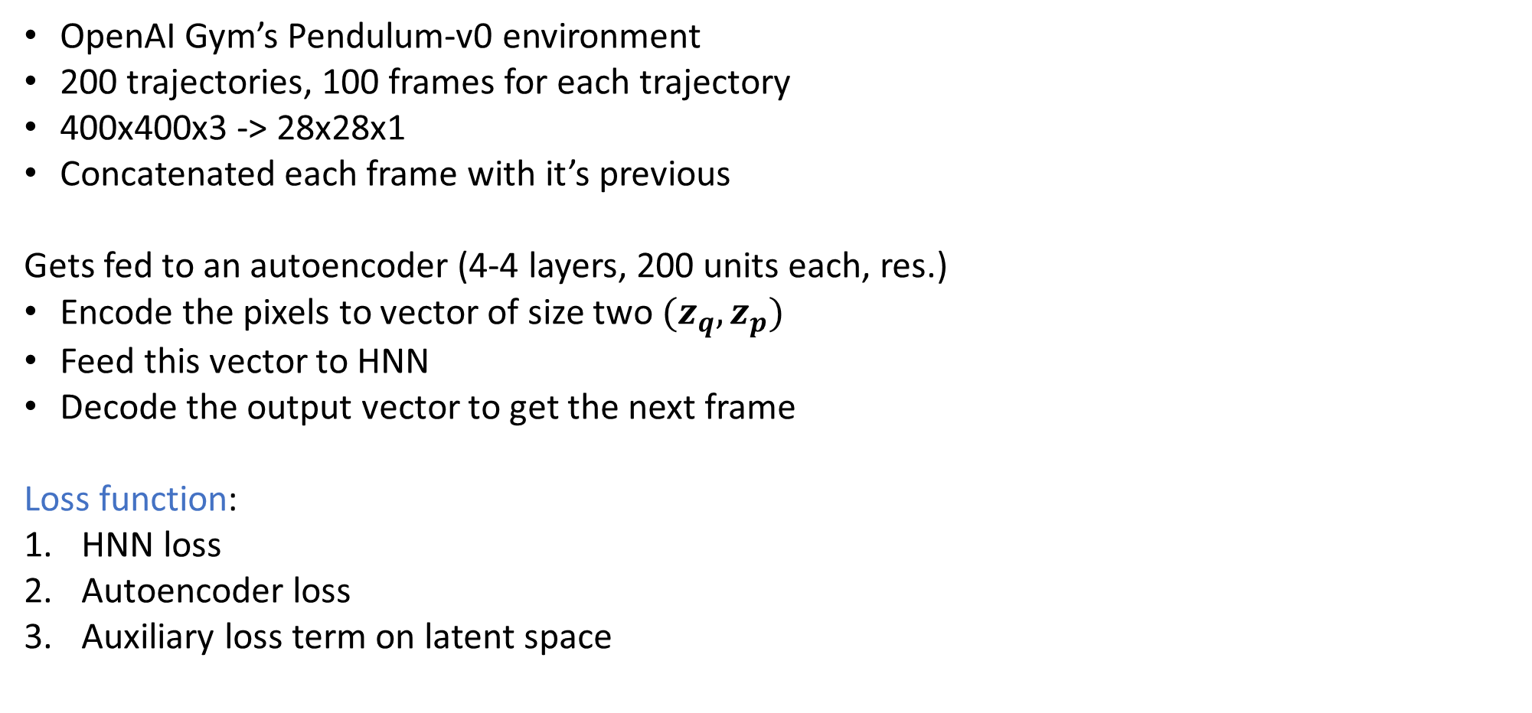
Learning a Hamiltonian from Pixels
12
OpenAI Gym’s Pendulum-v0 environment
200 trajectories, 100 frames for each trajectory
400x400x3 -> 28x28x1
Concatenated each frame with it’s previous
Gets fed to an autoencoder (4-4 layers, 200 units each, res.)
Encode the pixels to vector of size two $(z_{q}, z_{p})$
Feed this vector to HNN
Decode the output vector to get the next frame
Loss function:
HNN loss
Autoencoder loss
Auxiliary loss term on latent space

Slide 13
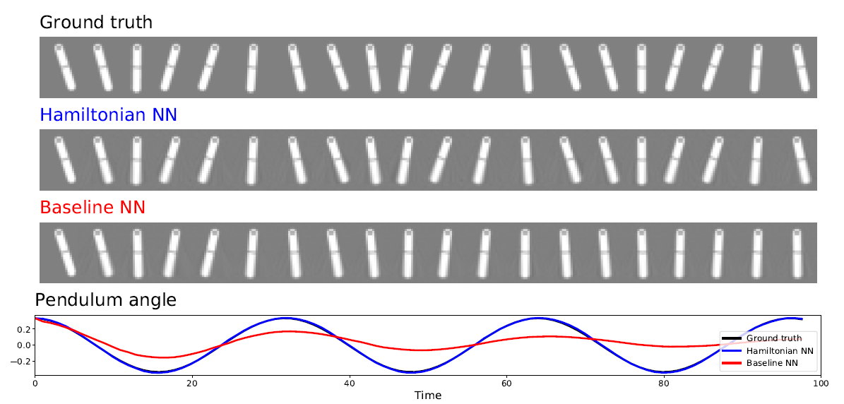
Learning a Hamiltonian from Pixels
13

Slide 14
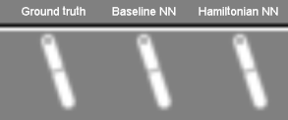
Learning a Hamiltonian from Pixels
14

